Slide 1
Sentiment Classification
An exercise in dimensional management

Slide 2

Does Language even have features?
Spent a fair bit of time clawing at a featureless dataset
Pictured Right: What I ran into

Slide 3

What was empty
Does now become full.
18 million is a very large number
No way to model this

Slide 4

Shifting Challenge
No longer “what features can I add”
But “How few features can I squeeze the relevant information into?:
Right: Squeezing

Slide 5

No domain knowledge
Silver tongue, but formal language is foreign

Slide 6

One layer of abstraction out
Tools provided possibility space, one layer of abstraction provided larger possibility space.
One layer out is enough to explore, but not enough to be computationally impossible
Right: the grid I was establishing

Slide 7
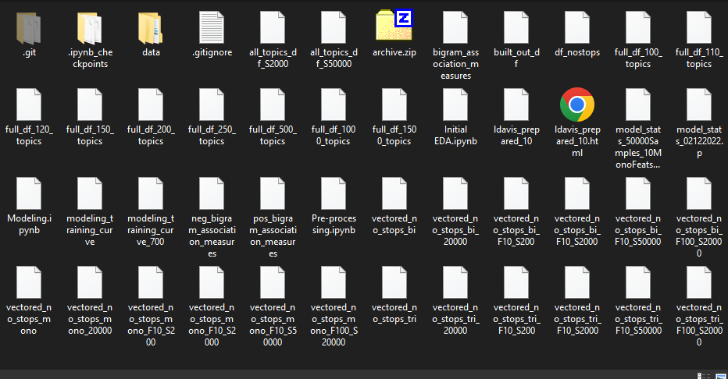
I did a lot of testing
Empiricism as a replacement for understanding
Dimensionality
Inputs
Hyper parameters(Depreciated)

Slide 8
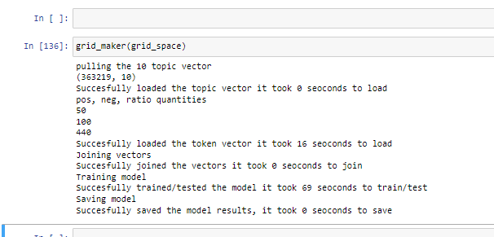
Approach
Dimensionality: Scoped!
Input Parameters
Single Polarity Only
High Ratio
Topic Vector

Slide 9

Unexpected
Single Polarity : Ineffective
Ratio: Impactful
Topics: Counter productive?
Effect: Small
Pictured right: Size of effect

Slide 10
Next steps
Oh boy, so much I wish I could have done.
More exhaustive search of the input parameter space described by our dimensionality constraint
Instantiate a local spark network so I can scale up a bit more/deal with the fragility of the jupyter notebook (I crashed it so, so many times)
Apply a neural net
Their epoch system would probably allow me to hit larger scales as well
Suspect I could get more accuracy with one of these as there’s a lot of implicit feature generation for it to do.
I had three more labeled datasets and I would have loved to include those, but I was already maxing out on dimensionality with my single dataset
I really would love to have explored more n-grams. Now that I have my lexical slicing pattern established there could be some work done there
I also suspect that slicing pattern could be productive if mixed with the n-gram association vectors somehow. Lots to explore...
Better/more hyper parameter testing, cross validation and a bunch of other little improvements
I had a lot of these in place but near the end I was madly stripping away complexity to get things to run on my local machine.
I would love to test my model on other labeled datasets. I suspect it has poor generalizability but I don’t know yet.

